Slide 1
Annual Report
2015
Department of Internal Medicine
Suhrawardy Medical College & Hospital

Slide 2
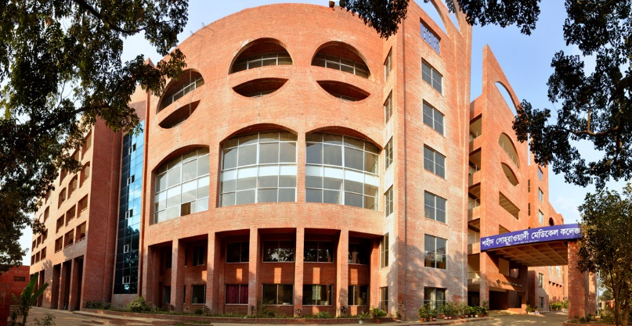
Shaheed Suhrawardy Medical College and Hospital

Slide 3
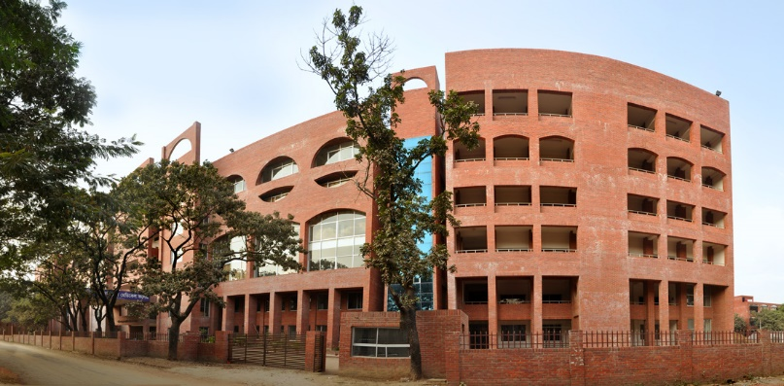
Shaheed Suhrawardy Medical College and Hospital

Slide 5
History at a glance
1964 – This hospital started its journey as Ayub Central Hospital
  OPD including pathology and radiology
  Indoor: at first with 5 beds, increased to 25 beds later
1972 – After the Independence of Bangladesh, Bangabandhu Sheikh Mujibur Rahman renamed this hospital as Shaheed Suhrawardy Hospital
  It included 75 indoor beds with OPD facilities

Slide 6
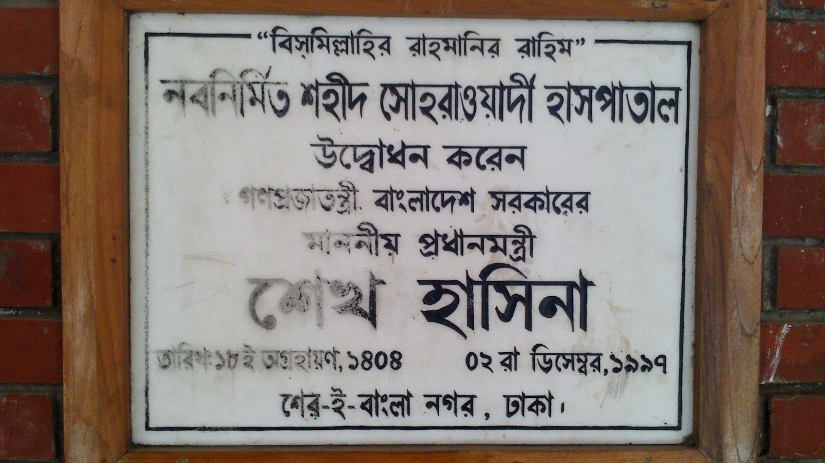
History at a glance
1997 – The then Prime Minister Sheikh Hasina inaugurated three storied new extension building behind outdoor building with new decoration and extended indoor facilities.

Slide 7
History at a glance
At this time, the bed number was increased to 375 beds with increased facilities.
2006 –
  26th February, permission for admission of MBBS students for academic year 2006-2007 was given by MOHFW as 14th Government Medical College.
  April 2006, first batch of MBBS students was admitted.

Slide 8
History at a glance
At 1st 100 MBBS students were admitted.
This number has now increased to 150 MBBS students.
2009 – Dental unit started its academic session with 50 students each year.

Slide 9
History at a glance
2012 – The college building including hostels was established and inaugurated on January 17, 2012 by Sheikh Hasina, the Honourable Prime Minister of Peoples’ Republic of Bangladesh.
2013 – Approval for 850 bed was given

Slide 10
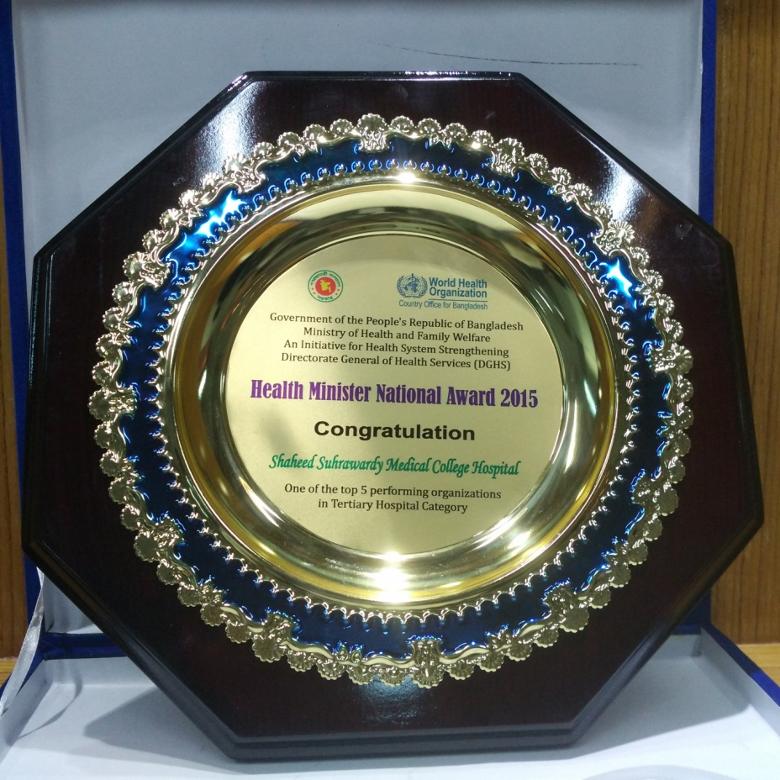
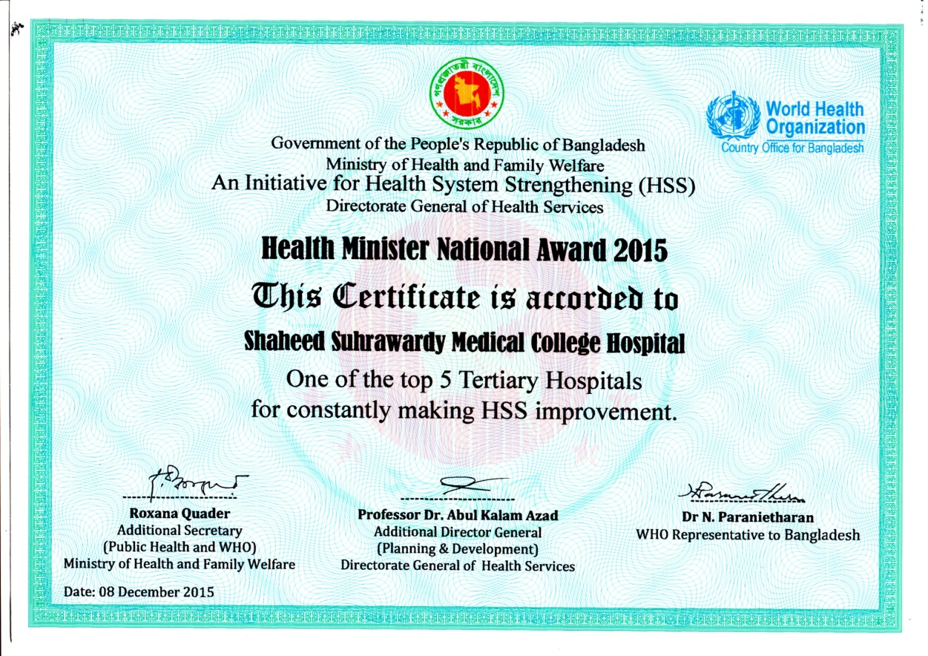
History at a glance
2015 – Health Minister National Award for becoming one of the top 5 Tertiary Hospitals

Slide 11
Faculties
  Clinical:
    Medicine & allied:
      Medicine
      Gastroenterolgy
      Hepatology
      Neuromedicine
      Cardiology
      Nephrology
      Respiratory Medicine
      Physical Medicine
      Skin & VD
      Oncology

Slide 12
Department of Internal Medicine
Suhrawardy Medical College & Hospital

Slide 13
List of the teachers of department of Medicine
Prof. Dr. Md. Ridwanur Rahman | Professor & Head
Prof. Dr. Md. Mujibur Rahman | Professor
Prof. Dr. AHM Feroz | Professor
Dr. Md. Ismail Hossain | Associate Professor
Dr. Gazi Khan Md. Shahiduzzaman | Associate Professor
Dr. Gobinda Chandra Roy | Associate Professor
Dr. Hafez Md. Nazmul Ahsan | Assistant Professor
Dr. Akhlak Ahmed | Associate Physician

Slide 14
Trainees and Students
  Undergraduate students:
    MBBS
    BDS
  Post-Graduate Traininees:
    FCPS training
    MD & MS training

Slide 15
Academic Activities
MBBS and BDS classes (Theory and clinical classes)
Post Graduate course classes(Theory and clinical classes)
Weekly Grand Round
Weekly Journal club
Fortnightly Death Review
Regular conduction of FCPS II Medicine clinical Examination and MCPS clinical Examination in cllaboration with BCPS

Slide 16
Research Activities
Kala Azar Research
Dengue
Febrile illness
Drug Trials: Renal Lupus
MAC Dengue Trial

Slide 17
Specialized Clinic Run by department of Medicine
Rheumatology Clinic
Lupus Clinic
Fever Clinic
Kala Azar Clinic
Hypertension Clinic

Slide 18
Statistics of OPD & IPD Patients in department of Medicine , January – December / 2015
Shaheed Suhrawardy Medical College Hospital
Year | January | February | March | April | May | June | July | August | Sept | Oct | Nov | Dec |  | Total
OPD
2015 | 13241 | 13984 | 14186 | 14262 | 14767 | 15122 | 16941 | 17433 | 16845 | 16424 | 15427 |  | 15332 | 183964
IPD
2015 | 947 | 921 | 1024 | 1146 | 1142 | 1179 | 1676 | 1571 | 1565 | 1443 | 1378 |  | 1248 | 15240

Slide 19
Thank You

